Slide 1
Internet coaches for problem-solving in introductory physics: Experimental design
Leon Hsu, Ken Heller, Qing Xu
University of Minnesota–Twin Cities
Supported by NSF DUE #0715615
and by the University of Minnesota

Slide 2
Motivation
What is problem solving?
“Problem solving is the process of moving toward a goal when the path to that goal is uncertain.” (Martinez, 1998, p. 605)
Problem solving skills are highly valued:
Numerous recent reports from the National Academies, the AAS, NSF, etc. have emphasized the important of skills for non-routine problem solving
Introductory physics, as a gateway course for nearly all STEM fields, provides an ideal venue for teaching problem solving. However, many students emerge introductory physics courses not appreciably better at solving problems than when they entered.

Slide 3
Teaching problem solving
Numerous research-based reform curricula exist with evidence of improving students’ problem-solving skills (in limited, laboratory trials)
These curricula are all based, implicitly or explicitly on the cognitive apprenticeship framework (Collins, Brown, and Newman, 1989)
Based on traditional apprenticeship
Make invisible (cognitive) processes explicit
Context of formal schooling

Slide 4
Cognitive apprenticeship
Main components
Modeling: Teacher demonstrates the skill
Coaching: Student attempts the task as teacher provides individualized guidance and feedback
Fading: Students attempts the task more independently, teacher withdraws support
Scaffolding: Tools and supports to help the student develop better performance during all phases of learning

Slide 5
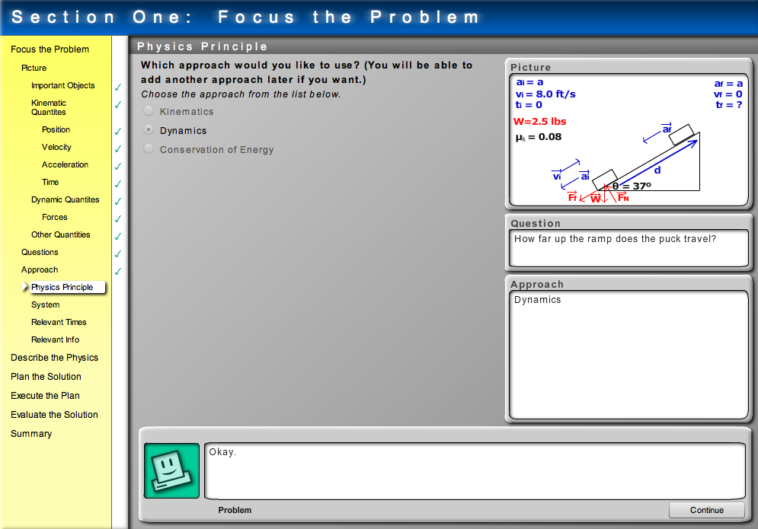
Minnesota computer coaches
Type 1
Computer coaches student
Type 2
Student coaches computer

Slide 6
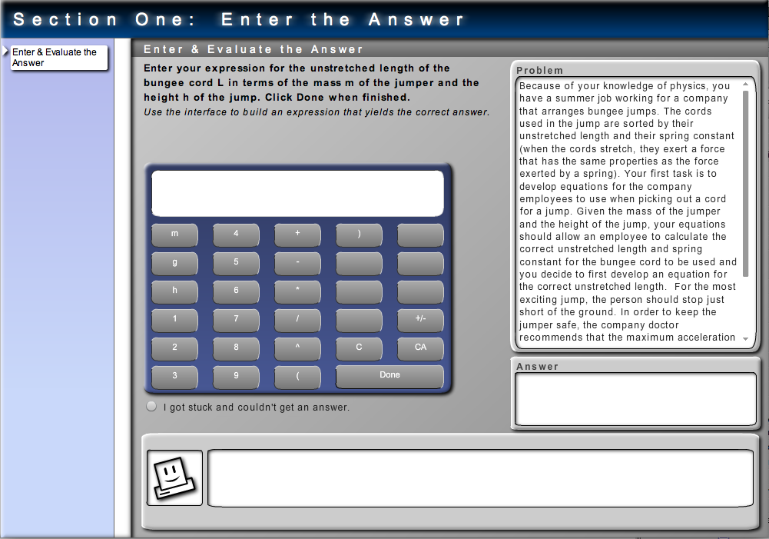
Minnesota computer coaches
Type 3
Student works more independently

Slide 7
Computer coaches and cognitive apprenticeship
• Scaffolding is provided through context-rich problems,
which discourage the use of novice problem-solving habits.

Slide 8
Pilot test
Computer coaches were integrated into a 219-student calculus-based introductory mechanics course in Fall 2011.
Student could get credit for homework either by entering the correct answer in WebAssign (within 3 tries) or by working through the computer coach.
Data was collected in the form of:
Pre/post-test scores for students in the class
13 written problem solutions from 4 midterms (2 problems each) and a final exam (5 problems)
A survey of student opinions regarding the coaches
5 written problem solutions from a comparison section of the same class not using the coaches

Slide 9
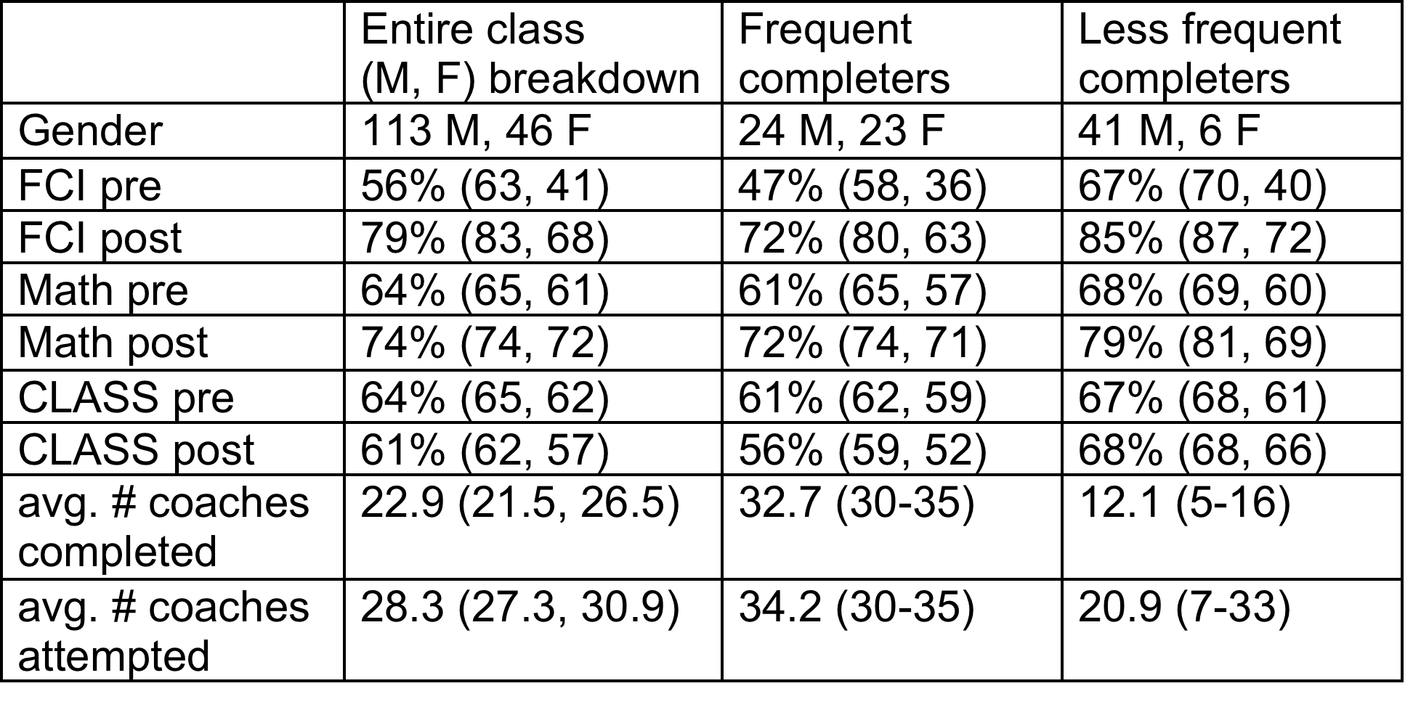
Some results
Students frequently chose to use the coaches.
Students with lower pre-test scores used the coaches more frequently than those
The fraction of frequent completers who were female is much larger than the same fraction of less-frequent completers.

Slide 10
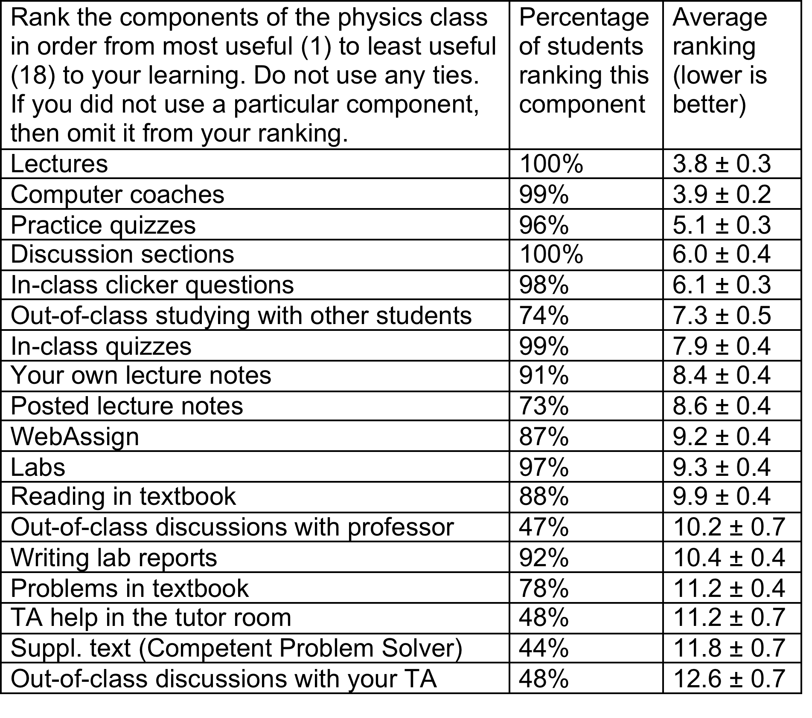
Some results

Slide 11
Summary
Students believe that the coaches were valuable to their learning.
The characteristics of students in the frequent and less-frequent completer categories differed drastically is terms of pre-test scores and female:male ratio.
Impact of the coaches on students’ problem-solving coming up in the next talk…
For further information:
Visit our posters (PST2A39 and PST2A40, Houston Hall, 6 – 7:30 p.m. tonight)
Visit our website http://groups.physics.umn.edu/physed where you can try working version of the coaches.

